Slide 1
Data breach & credit monitoring services
STATE OF IDAHO
Division of Purchasing
NASPO ValuePoint

Slide 2
Sourcing Team
Valerie Bollinger, Idaho- Lead State
Janet DelGreco Olson, Connecticut
Tim Jenks, Oregon
Julie Matthews, California
Doug Selix, Washington
Tim Hay, NASPO ValuePoint

Slide 3
Purpose
“The contract no one wants to need.”
In the event that sensitive data is compromised, the Participating Entity may immediately initiate services with one of the contractors.
Benefits: no need for an emergency procurement; already have a relationship with the contractor.

Slide 4
Scope of Services
Three main areas of services in addition to general preparation. Participating Entities may choose to use some or all of the services.
Sample Notification Plan
Upon execution of a PA, the Contractor must work with each Participating Entity to develop a sample Notification Plan and template based on each PE’s requirements in order to facilitate timely notification in the event of a breach.
Notifications:
Assistance in drafting notification
Printing and mailing of notifications

Slide 5
Scope of Services continued
Call Center Services:
Dedicated phone number, staffed 24x7
Participating Entity may provide a FAQ script
Credit Monitoring Services:
Participating Entity may choose 1-bureau or 3-bureau credit monitoring
Includes other identity theft protection
Identity theft restoration services
$1 million in identity theft insurance

Slide 6
RFP Process
Release date: October 21, 2015
Pre-proposal conference: October 29, 2015
RFP Amendments: Three
Closing date: December 8, 2015
Proposals received: Four
Master Agreements: Two contracts awarded
Contract Term: February 23, 2016 – February 22, 2018; not to exceed five (5) years total.

Slide 7
Evaluation Criteria (general)
Mandatory Submission Requirements Pass/Fail
Business Information 100 pts
Organization and Staffing 150 pts
Scope of Work 350 pts
Cost Proposal 400 pts

Slide 8
Evaluation Criteria (detailed)
Business Information
Business Profile
General business information including organizational structure, client base, growth rate, etc. Minimum of five (5) years experience required.
Experience
Experience with statewide or large consortium contracts; details of size and scope of breach experience.
References
Reference Questionnaires requested from a minimum of three (3) references.

Slide 9
Evaluation Criteria (detailed)
Organization and Staffing
Contract Manager
Experience of the person who will be the point for contact for managing the NASPO ValuePoint Master Agreement; five (5) years of experience required.
Breach Response Specialist
Role of the person who will be the initial contact in the event of a breach.
Call Center Customer Service Representatives
Qualifications and training requirements for call center representatives.
Identity Restoration Personnel
Qualifications and training requirements for ID restoration personnel.
Other Key Positions/Personnel
Other roles involved in performance of the contract and qualifications of the people in those roles.

Slide 10
Evaluation Criteria (detailed)
Scope of Work
Subcontractors
Extent to which Offeror intends to utilize subs and qualifications of the proposed subs.
Working with Participating Entities
Description of how the Offeror will work with PEs before, during, and after a data breach.
Notifications to Affected Individuals
Description of how the Offeror will work with PEs to send out notifications including experience with large breaches, capacity to meet legal requirements, and sample notification.
Enrolling Eligible Persons
Process of enrolling individuals, including methods, time, etc.
Credit and Identity Theft Monitoring
Methods used for credit and identity theft monitoring.

Slide 11
Evaluation Criteria (detailed)
Scope of Work continued
Alerts/Notifications
Process for alerting Active Participants of suspicious activity, including methods, time, information, etc.
Identity Theft Insurance
Details regarding insurance, including copies of policies.
Identity Theft Restoration Assistance
Services provided to assist Active Participants whose identities have been stolen.
Customer Service
How excellent customer service is guaranteed.
Available Language Options
Other languages in which services may be provided.
Security of Information
Security measures taken to secure sensitive information (i.e. avoid secondary breach.)

Slide 12
Evaluation Criteria (detailed)
Cost Proposal- tiered unit pricing for four (4) categories of services; average unit price for each category used for evaluation purposes.
Notifications
Cost per notification (single duplex page, #10 envelope, first class postage)
Call Center Services
Cost per call for general call center
Single-bureau Credit Monitoring
One year of service per person enrolled (incl. single-bureau credit and identity theft monitoring, identity restoration services, and insurance)
Triple-bureau Credit Monitoring
One year of service per person enrolled (incl. tripe-bureau credit and identity theft monitoring, identity restoration services, and insurance)

Slide 13
Evaluations- Normalization
Scores were normalized according to the explanation in the RFP document.
Top score for technical received all available technical points; all other proposals received technical points in proportion to their technical scores.
Lowest average unit price received all available cost points by category; all other proposals received cost points in proportion to their average unit prices.

Slide 14
Evaluation Results
Responsive Offerors | Technical Points | Cost Points- Notifications | Cost Points- Call Center | Cost Points- Single-bureau Credit Monitoring | Cost Points- Triple-bureau Credit Monitoring | TOTAL POINTS
CS Identity | 600 | 100 | 10.50 | 100 | 100 | 910.50
ID Experts | 475.65 | 42.65 | 100 | 47.15 | 66.35 | 731.80
Note: Two (2) proposals were found non-responsive; only the two (2) remaining proposals were fully evaluated.

Slide 15
Contracts Awarded
Master Agreements were awarded to both responsive Offerors. The reason for awarding to both was to help increase capacity to respond to multiple breaches at one time.
CS Identity (CSID)- Master Agreement 16000460-01
Contact: Joel Lang
jlang@csid.com
512.921.9449
ID Experts- Master Agreement 16000460-2
Contact: Katrina Day
Katrina.day@idexpertscorp.com
503.788.9333

Slide 16
Contract Structure
Service | CSID | ID Experts
Notifications | CSID uses subcontractors to send notifications. A specific subcontractor (Rust Consulting) was identified and evaluated through the RFP. | ID Experts provides some notification services directly; ID Experts also uses subcontractors depending on the circumstances. A specific subcontractor (Epiq) was identified and evaluated through the RFP.
Call Center | CSID uses subcontractors to provide call center services. A specific subcontractor (Rust Consulting) was identified and evaluated through the RFP. | ID Experts provides some call center services directly; ID Experts also uses subcontractors depending on the circumstances. A specific subcontractor (Epiq) was identified and evaluated through the RFP.
Credit Monitoring | CSID provides credit monitoring and associated services directly. | ID Experts utilizes CSID as a subcontractor for providing credit monitoring and associated services.

Slide 17
Pricing Information- Notifications
Size of Breach (# of Eligible Persons) | Cost per Notification* CSID | Cost per Notification* ID Experts
0 – 10,000 | $0.60 | $2.48
10,001 – 100,000 | $0.59 | $2.15
100,001 – 500,000 | $0.58 | $1.00
500,001 – 1,000,000 | $0.57 | $0.90
1,000,001 – 5,000,000 | $0.56 | $0.87
5,000,000+ | $0.55 | $0.75
* Based on single page (duplex) notification, #10 envelope, and first class postage

Slide 18
Pricing Information- Call Center
Size of Breach (# of Eligible Persons) | Cost per Call CSID | Cost per Call ID Experts
0 – 10,000 | $12.00 | $3.28
10,001 – 100,000 | $12.00 | $2.05
100,001 – 500,000 | $12.00 | $0.75
500,001 – 1,000,000 | $12.00 | $0.55
1,000,001 – 5,000,000 | $12.00 | $0.50
5,000,000+ | $12.00 | $0.40

Slide 19
Pricing Information- Single-Bureau Credit Monitoring
Number of Active Participants (# enrolled) | One Year Single-Bureau Credit Monitoring/Identity Theft Protection CSID | One Year Single-Bureau Credit Monitoring/Identity Theft Protection ID Experts
0 – 1,500 | $14.16 | $28.00
1,501 – 15,000 | $13.56 | $25.00
15,001 – 75,000 | $12.48 | $24.00
75,001 – 150,000 | $11.88 | $23.00
150,001 – 750,000 | $10.68 | $22.00
750,000+ | $10.20 | $18.00

Slide 20
Pricing Information- Triple-Bureau Credit Monitoring
Number of Active Participants (# enrolled) | One Year Triple-Bureau Credit Monitoring/ Identity Theft Protection CSID | One Year Triple-Bureau Credit Monitoring/ Identity Theft Protection ID Experts
0 – 1,500 | $32.52 | $50.00
1,501 – 15,000 | $31.92 | $49.00
15,001 – 75,000 | $31.08 | $45.00
75,001 – 150,000 | $29.64 | $43.00
150,001 – 750,000 | $28.32 | $40.00
750,000+ | $27.48 | $33.00

Slide 21
Sample Breach Scenario
State of Pennsyltucky’s Department of Tax has a breach of its online tax submission system, compromising the Personally Identifiable Information (PII) of 1,500,000 citizens.
Pennsyltucky must send written notifications and has decided to offer free triple-bureau credit monitoring to all affected individuals.
Assume 10% of eligible persons call the call center and 8% enroll in credit monitoring.

Slide 22
CSID
Service | Quantity | Unit Price | Extended Price
Notifications | 1,500,000 | $0.56 | $840,000.00
Call Center | 150,000 | $12.00 | $1,800,000.00
Triple-Bureau Credit Monitoring | 120,000 | $29.64 | $3,556,800.00
TOTAL COST |  |  | $6,196,800.00
ID Experts
Service | Quantity | Unit Price | Extended Price
Notifications | 1,500,000 | $0.87 | $1,305,000.00
Call Center | 150,000 | $0.50 | $75,000.00
Triple-Bureau Credit Monitoring | 120,000 | $43.00 | $5,160,000.00
TOTAL COST |  |  | $6,540,000.00

Slide 23
Getting Started
Participating Addendum Process
Develop sample Notification Plan with Contractor(s)
If a breach occurs, contact Contractor(s) to discuss the specifics.
Activate the services you need.

Slide 24
Questions?
Contract Lead:
Valerie Bollinger
State of Idaho
Division of Purchasing
208-332-1631
Valerie.Bollinger@adm.idaho.gov

Slide 25
Participating Addendum Process

Slide 26
PA Process
All 50 states and The District of Columbia have executed the NASPO Cooperative MOA, allowing them to be eligible to use any NASPO ValuePoint cooperative Master Agreement
Notes:
26

Slide 27
Opportunities for Participation
Three Options for Participation
State signs a Participating Addenda for entire state
Every legally eligible entity in the state can participate
State signs a Participating Addenda for non state entities
Every legally eligible entity that is not a STATE agency can participate
State does not sign a Participating Addenda
Political subdivisions wishing to participate may contact the NASPO ValuePoint Cooperative Development Coordinator who will contact the STATE CHIEF PROCUREMENT OFFICIAL asking for approval for that entity to sign their own Participating Addendum.
Entities may be given approval on an individual basis or State CPO may give approval to all entities within the state to execute their own Participating Addendums.
Notes:
27

Slide 28
Participation Opportunity #1
Step by Step:
Participating Addendum templates are available on each Master Agreement page on www.naspovaluepoint.org
States may have submitted Intents to Participate during solicitation, this will provide the information for contractors to contact states interested in signing a Participating Addendum.
States may also contact contractors directly to begin Participating Addendum process.
State Chief Procurement Officials (or designated representative) will be the signatory on the Participating Addendum. They will also be the NASPO ValuePoint point of contact throughout the process.
State completes the draft Participating Addendum for each contractor and then forwards the draft to the contractor. Negotiations will be handled directly between state and contractor. Upon agreement, the state sends a final copy of Participating Addendum to the contractor for signature.
Contractor signs Participating Addendum and sends back to state for signature.
State sends fully executed copy to both contractor and NASPO ValuePoint at
PA@naspovaluepoint.org
Executed Participating Addendum will be maintained in a repository.

Slide 29
Participation Opportunity #2
Step by Step: Same Process as Opportunity #1
Participating Addendum templates are available on each Master Agreement page on www.naspovaluepoint.org
States may have submitted Intents to Participate during solicitation, this will provide the information for contractors to contact states interested in signing a Participating Addendum.
States may also contact contractors directly to begin Participating Addendum process.
State Chief Procurement Officials (or designated representative) will be the signatory on the Participating Addendum. They will also be the NASPO ValuePoint point of contact throughout the process.
State completes the draft Participating Addendum for each contractor and then forwards the draft to the contractor. Negotiations will be handled directly between state and contractor. Upon agreement, the state sends a final copy of Participating Addendum to the contractor for signature.
Contractor signs Participating Addendum and sends back to state for signature.
State sends fully executed copy to both contractor and NASPO ValuePoint at
PA@naspovaluepoint.org
Executed Participating Addendum will be maintained in a repository.

Slide 30
Participation Opportunity #3
Step by Step:
Participating Addendum templates are available on each Master Agreement page on www.naspovaluepoint.org
An email request should be sent to PA@naspovaluepoint.org
from entity (email may also be sent from contractor). The email needs to provide the following details: main point of contact from entity, full name of entity, phone number, email address and physical address.
NASPO ValuePoint will email State Chief Procurement Officer requesting approval for the entity to execute a Participating Addendum.
NASPO ValuePoint will email both contractor and entity with the permission from Chief Procurement Official to proceed to complete the Participating Addendum.
Entity completes the draft Participating Addendum for contractor and then forwards the draft to the contractor. Negotiations will be handled directly between entity and contractor. Upon agreement, the entity sends a final copy of Participating Addendum to the contractor for signature.
Contractor signs Participating Addendum and sends back to entity for signature .
Entity sends fully executed copy to both contractor and NASPO ValuePoint at PA@naspovaluepoint.org
Executed Participating Addendum will be maintained in a repository.

Slide 31
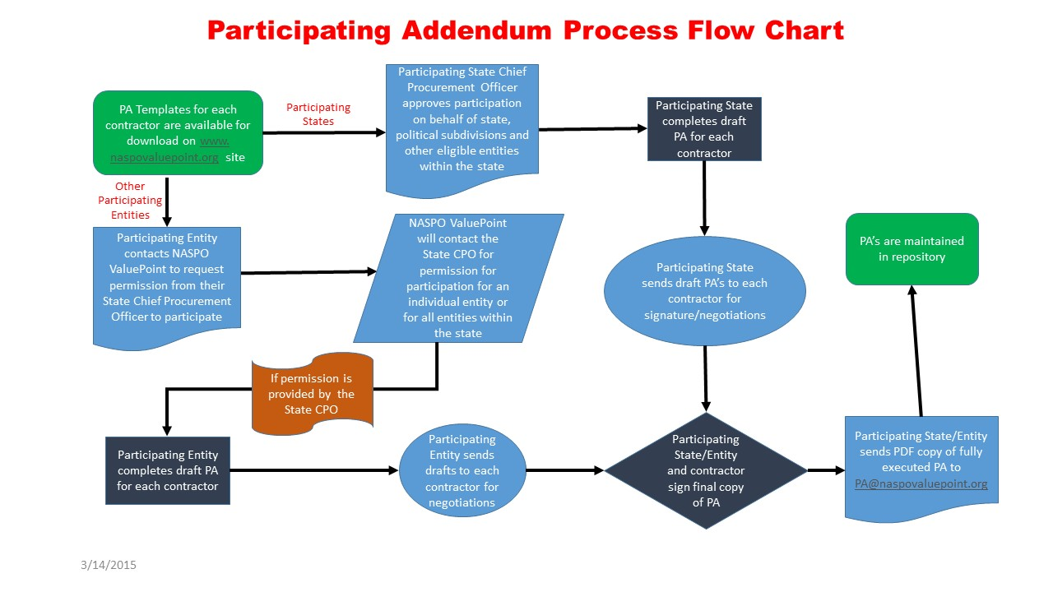
PA Process Flow Chart

Slide 32
Things to Remember
Sample PA’s are located on the NASPO ValuePoint Website under each master agreement portfolio.
Executed Participating Addendum will be maintained on www.naspovaluepoint.org and in a repository.
Participating states and entities will be identified on the map of the USA on each Master Agreement page on www.naspovaluepoint.org
The Lead State and NASPO ValuePoint do not get involved with negotiations.
Only submit completed and negotiated PA’s with signatures from both parties.
Submit completed PA’s in PDF Format
Notes:
32

Slide 33
Thank You
Please let NASPO ValuePoint know if we can be of any assistance:
*Tim Hay, NASPO ValuePoint Cooperative Development Coordinator thay@naspovaluepoint.org (503) 428-5705
* NASPO ValuePoint Point of Contact for these Master Agreements.
Notes:
33

