Slide 1
Idaho Division of Purchasing
Quarterly Workshop
August 7, 2019

Slide 2
Workshop Agenda
9:00 – 9:05 Introduction (Forrest Benedict)
9:05 – 9:30 Administrator Update (Steve Bailey)
9:30 – 9:45 State Purchasing Manager Update (Valerie Bollinger)
9:45 – 10:05 Statewide Contract Updates (DOP Staff)
10:05 – 10:20 Networking Break
10:20 – 10:40 Jaggaer updates and best practices (Karen Butler, Forrest Benedict)
10:40 – 11:15 New Vehicle Ordering Process (Danny Downen)
11:15 – 11:45 Presentation by Correctional Industries (Terry Tharp)
11:45 – 12:00 Open Discussion (All)

Slide 3
Introduction
Forrest Benedict

Slide 4
Administrator’s Update
Steve Bailey

Slide 5
60-Day Priorities
People
Performance
Support
Conduct summer team building events
Post and hire Contract Administrators
Address Luma backfills
Research team personality testing
Conduct 1:1 meetings on expectations
Implement metric tracking and reporting
Conduct leadership offsite
Implement various efficiency improvements
Submit budget request for Purchasing assessment consulting
Publish a revised DPA policy
Perform a review of key processes
Develop a plan to implement DOP Advisory Committee
Implement customer service training
Publish DOP communication standards
Communicate 60-day priorities to DOP and agency stakeholders

Slide 6
DOP Vision and Mission
Conduct leadership offsite
Our Vision
We are recognized leaders in public procurement by serving as trusted advisors and partners, contributing to Idaho’s strategic initiatives, and delivering outstanding customer service.
Our Mission
Our mission is to procure quality goods and services for the benefit of the people in the State of Idaho through collaborative, effective, and innovative procurement solutions. We promote an understanding of public procurement through quality guidance, training, and professional development.

Slide 7
DOP Communication
Publish DOP communication standards
Team Communication Response Standards
Communication | Standard Response Threshold
Voicemail | 8 business hours
Email | Within next business day
IPRO new work assignment | Within next business day
Exemption requests | Acknowledge – 8 business hours Process – 5 business days

Slide 8
DOP Performance Metrics
Implement metric tracking and reporting

Slide 9
Exemption Requests
Implement various efficiency improvements
WebCorrespondence
purchasing@adm.idaho.gov

Slide 10
Exemption Requests
Implement various efficiency improvements
WebCorrespondence
purchasing@adm.idaho.gov

Slide 11
Exemption Requests
Implement various efficiency improvements
Helpful Pointers for exemption requests
“Connect the dots” in your justification
Write it as if someone may contest it
Help DOP help you!
Questions are meant to help us understand the request so we can help strengthen it and to ensure the exemption is legal

Slide 12
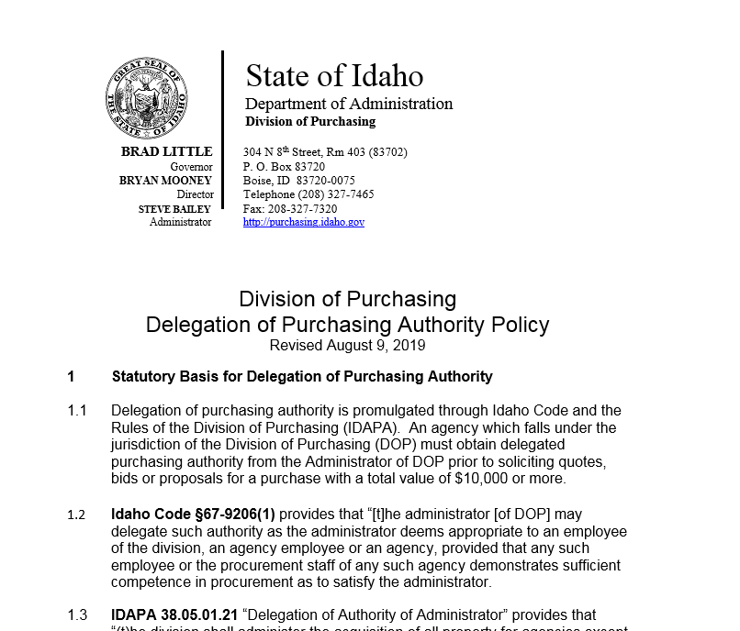
Delegated Purchasing Authority Policy
Publish a revised DPA policy
A revised DPA policy will be released on August 9
Input provided by DOP, DAG and select agencies
Goals of the revised DPA policy
Cleanup dated content
Make decision regarding DPA transparent and objective
Ensure statewide Purchasing is done in a consistent and legal manner
Provide opportunity for more agencies to have DPA

Slide 13
Delegated Purchasing Authority Policy
Publish a revised DPA policy
Major Revisions
DPA holder is being moved to the agency Director or senior leader
Sub-delegation is expected
Statewide DPA certification process has been established
Experience and education components
Annual certification of Purchasing team will be required
Guide for DPA limits has been developed
Based on certification level of agency Purchasing team

Slide 14
Delegated Purchasing Authority Policy
Publish a revised DPA policy
Jul-Aug 2019
Policy revised & released
Jan 1, 2020
Policy effective for new DPA
Jan 1, 2021
Policy effective for all DPA
Current DPA grandfathered
*Available certification training to be completed by Jan 1, 2021
Ongoing training
* Certification training that is not available will be waived until it is available

Slide 15
State Purchasing Manager’s Update
Valerie Bollinger

Slide 16
IDAPA Overview
All but one subsection of DOP’s pending rules were approved by the 2019 legislature
Entirety of IDAPA 38.05.01 (effective as of 2019 sine die) was re-issued as a temporary rule on July 1, 2019
DOP is not proposing any additional changes to the purchasing rules for 2020

Slide 17
IDAPA Highlights
New solicitation type: Invitation to Negotiate (ITN)
This is a competitive negotiation– still requires an open competitive process, but allows for more dialogue and negotiation with multiple finalists
Requires Administrator approval; being used on a limited basis
Purchasing records
Purchasing authority may determine the form in which records are maintained (e.g. electronic vs. hard copy)
DOP officially moved to electronic format as on August 1, 2019 for contract/solicitation files

Slide 18
IDAPA Highlights
Key Points:
Not intended to cover services that can be competed or major changes to scope of original solicitation– still must demonstrate that bidding would be impractical, disadvantageous, or unreasonable.
Example: Annual licensing and maintenance for existing software
IDAPA 38.05.01.042. EXCEPTIONS TO COMPETITION.
10. Exempt Purchases. By written policy the administrator may exempt from the formal sealed procedure or the requirement for competitive solicitation that property for which bidding is impractical, disadvantageous or unreasonable under the circumstances…
a. Examples include, but are not limited to:…
vi. Ongoing maintenance, upgrades, support or additional licenses for software or other information technology solutions, including a change in the manner of solution delivery; which software or solution was originally acquired in compliance with the purchasing laws in effect at the time of acquisition;

Slide 19
Recruiting Efforts
Contract Administrators
Two new FTEs- one on each DOP team
Purchasing staff will “hand off” contracts- CAs will be primarily responsible for renewals, amendments, performance issues, proactive contract administration
First round of interviews being conducted this week- hope to have people onboarded in early September
Luma backfill
Jason Skelton will be leading the Procurement Team for the Controller’s Luma implementation
DOP will be hiring for a limited service position to backfill- position posted yesterday

Slide 20
Communications: Reminder
IPRO
IPRO@adm.idaho.gov
Please do NOT email Karen or Forrest directly with IPRO questions/issues
Exemptions
purchasing@adm.idaho.gov
Please do NOT send directly to Steve, Valerie, Chelsea or Jason
Statewide Contracts
Email the DOP staff assigned to administer the statewide contract
Liaisons
Contact your liaison with general questions– he or she may not be the person with the answer, but can get you to the right person!

Slide 21
Qualtrics
DOP will be purchasing and implementing Qualtrics to conduct surveys and analyze results
Expect to see surveys related to customer satisfaction (general), solicitations, potential statewide contracts, training, etc.
Please participate!
Tovuti
DOP has implemented a Learning Management System
Stay tuned for information on how to set up your profile, register for classes, complete online training, review your transcript, and much more!

Slide 22
Statewide Contract Updates
DOP Staff

Slide 23
Networking Break

Slide 24
Jaggaer Update & Best Practices
Karen Butler

Slide 25
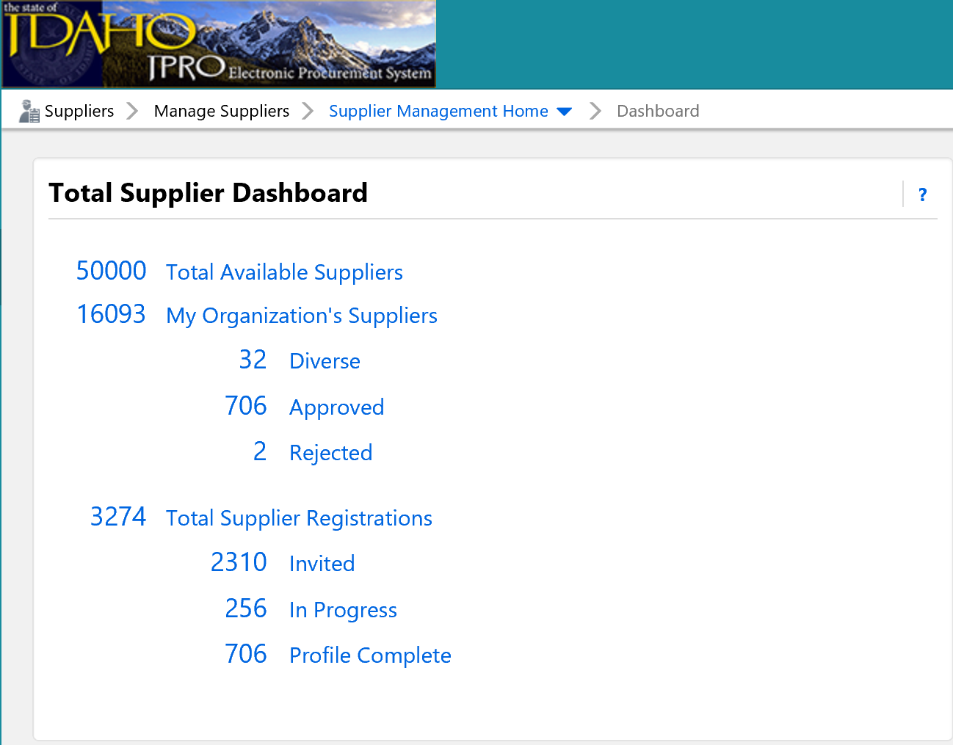
Jaggaer
Implementation
System implementation is complete
Technical Support or Questions: ipro@adm.idaho.gov
Supplier onboarding continues
3274 Idaho suppliers onboarded, more daily (~12,000 to go)
50,000 Jaggaer Suppliers available. What does that mean to you?
Suppliers can find information to login or register at purchasing.Idaho.gov/information-for-vendors
Public Site –Forrest Benedict
Process for posting: if a supplier needs to see it before they bid but it is posted in pre-reqs or questions duplicate as an attachment in Buyer Attachment section.

Slide 26
Amendments
How to:
Agency Owns Contract
DOP created contract on behalf of agency
Newsletter
Standard Operating Procedures (SOP)

Slide 27
New Vehicle Ordering Process
Danny Downen & Joey Nelson

Slide 28
Placing Your Vehicle Order
The Division of Purchasing
Updated 8/5/19

Slide 29
Step 1: Division of Purchasing website
Each Contractor has their individual pricing hyperlinked under their name.
Agencies will need to download the Vehicle Order Form.
You will need to review the order and production schedule for dates of the vehicle you are looking to order to ensure order cut-off hasn’t surpassed.

Slide 30
Step 1: Division of Purchasing Website Continued…
The Contract has been broken down into three geographic areas…A B and C. Each Contractor has been awarded per manufacturer per area. Make sure that you are sending your EXPO’s to the correct Contractor.
The Contract pricing is the most current up-to-date pricing the State has on record. They documents are living documents.

Slide 31
Step 2: Filling out the Vehicle Order Form (VOF)
The highlighted area will need to be filled out by the agency.
These sections should auto populate as the agency enters the cost in the price section
**NOTE: This is a new VOF. Make sure all the information is completely and accurately filled out.

Slide 32
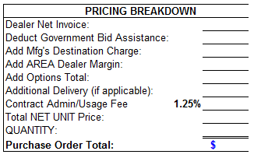
Make sure you match the corresponding information from the Contractor pricing to the Vehicle Order Form.
Step 2: Filling out the Vehicle Order Form (VOF) Continued…

Slide 33
Step 3: Options
All options for vehicles are coded and priced using Chrome Data.
Use the Invoice column when selecting the correct pricing
LOGIN: 265012
PASS: ida012
**NOTE: The system will only allow one person to be logged in at a time. Please be cognizant and respectful of your time in Chrome.

Slide 34
Step 3: Options Continued…
Research, Configure, and Compare is the tab you will need to select to begin the option selection process.
Year: Make sure the current model year is selected.
Make/Model: This is where you will find the pricing for a particular vehicle.

Slide 35
Step 3: Options Continued…
After selecting the category of vehicle (i.e. Chevrolet 1500) a list with all the vehicles types will be provide.
**NOTE: There will be the same Model Codes listed for several vehicles. Make sure you are selecting the correct vehicle as selecting the incorrect vehicle could potentially provide options that are not selectable for the vehicle you are requesting.

Slide 36
Step 3: Options Continued…
All options for the particular make and model for the vehicle selected are provided. Click the check box next to the option you would like to have provided. Pricing for the particular option will be listed under the invoice column.
**Please note: Some options may require you to add additional options which may come with a cost. Ensure that any additional are listed on the VOF

Slide 37
Step 4: Contacting the Contract
Once the Vehicle Order Form (VOF) is completely filled out (to include all options) you need to send a copy of the VOF to the Contractor.
The Contractor will review the VOF and correspond with the Ordering Agency if there are any corrections that need to be made.
If everything appears to be in order, the Contractor will sign and return the VOF to the Ordering Agency. This is your confirmation that your order has been placed.

Slide 38
QUESTIONS:

Slide 39
Correctional Industries
Terry Tharp

Slide 40
Training * Mentoring * Succeeding
Dedicated to Excellence

Slide 41
Sales and Marketing
Terry Tharp

Slide 42
Sales and Marketing
Mission
Idaho Correctional Industries (ICI) is dedicated to maintaining and expanding work training programs which provides meaningful education, work experience and transitional services to assist inmates reentering our communities become productive employees, good neighbors and taxpaying citizens, supporting victims of crime and creating safer communities.
Idaho Correctional Industries is committed to promoting a safer Idaho by:
Providing diversified training opportunities focused on vocational education and rehabilitation.
Reducing inmate idleness in Idaho’s prison system and maintaining our self funded status.
Vision
Idaho Correctional Industries provides life skills and marketable training opportunities to inmates which enable a better chance at successful re-entry into society.
Values
Respect
Positive Attitude
Integrity

Slide 43
Sales and Marketing
The following customers are eligible to purchase from Idaho Correctional Industries.
Idaho State agencies and political subdivisions of Idaho State - 310
Participating institutions of higher education (universities, community and technical colleges) - 14
Public, Primary and Secondary Schools - 769
Certified Not-For-Profit Organizations (within State of Idaho) – 12,690
Tribal/Indian Nation - 9
Retailer/Wholesalers (within State of Idaho) – Not for their end use.
Private contractors, when supplying any of the above entities – 2
Adequate opportunities!!

Slide 44
Sales and Marketing
Idaho State Correctional Institution (ISCI)
Carpentry Shop - Drafting Shop
Graphics Shop (Print, Sign & Decal)
License Plates - Metal Fabrication - Production Office
South Idaho Correctional Institution (SICI)
Agriculture - Transportation - Warehouse
South Boise Women’s Correctional Institution(SBWC)
Agriculture – “Future Opportunity” Customer Service!!
St. Anthony’s Work Camp (SAWC)
Agriculture - P.I.E. Program
Pocatello Women’s Correctional Center (PWCC)
“Future Opportunities” Embroidery & Screen Print

Slide 45
Sales and Marketing
Leaning into the Future
Logo/Brand/Standards
Dedicated to Excellence
To be the Best CI in the US
Via Training/Mentoring/Succeeding
“Excellence Begins Here”

Slide 46
Sales and Marketing
Sales Team
Becky Baker – 15 years
Mark LaFong – 9 years
Cindy Thorp – 5 years
Total Years of Experience – 29 Years!!

Slide 47
ICI Apprenticeship Certification

Slide 48
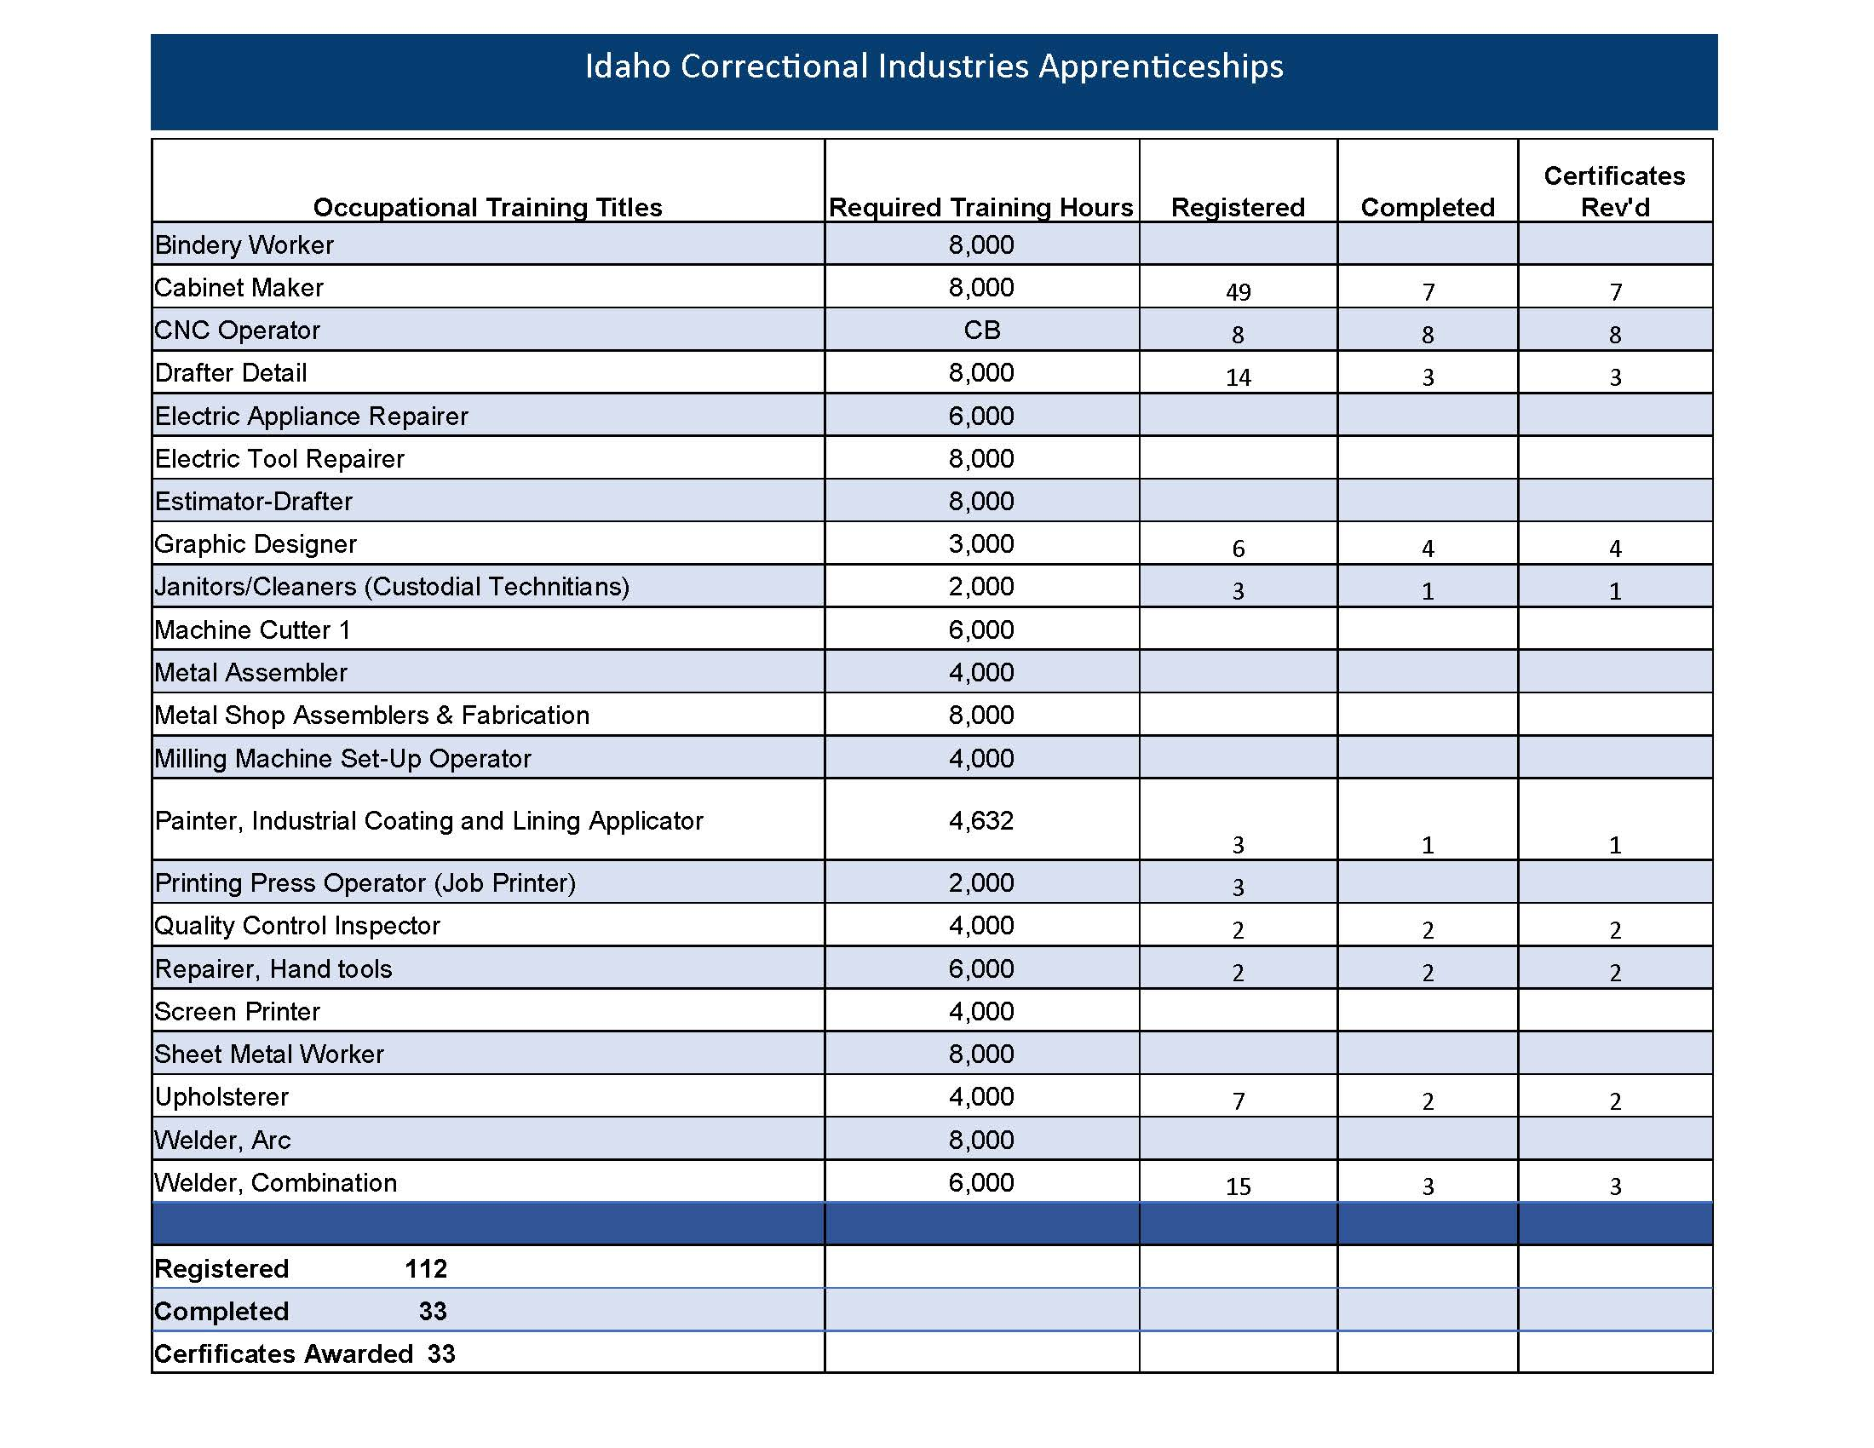

Slide 49
Sales and Marketing
Seven (7) Main Shops
22 Apprenticeships
2,000 to 8,000 hours (1 to 5 years)
Re-Entry Center – can continue on

Slide 50
Governor Little proclaims 7/1/19 as ICI Day!

Slide 51
Upcoming Events
Jaggaer Lunch-N-Learns
13 August – 1130-1pm, JRW West Conference Room 15 August – 1130-1pm, LBJ Basement B09 Jaggaer, Initial Training
20 August – 8am-2pm Quarterly Workshop
19 November – 9am-12pm Vendor Outreach
3 October- Capitol Building – 9am-3pm

Slide 52
Open Discussion
All

