Slide 1


Kaylee Starman contract Lead
Idaho department of administration division of purchasing
Statewide Temporary Staffing Services- Overview
August 6, 2019

Slide 2


Benefits
Awarded to multiple vendors to provide services Statewide for Public Agencies.
Obtain best value, and achieve more favorable pricing, than are obtainable by individual Agency Contracts.
Leverage collective volume of potential purchases by numerous Public Agencies.

Slide 3
Contract Term
One (1) year. Upon mutual, written agreement, the Contract may be renewed, extended or amended. The anticipated total Contract term is five (5) years.

Slide 4
Scope of Services
There are four categories that make up the scope of services for the Statewide Temporary Staffing Services awards:
MANDATORY USE: Administrative Support
Optional Use: Commercial/ Industrial
Optional Use: Healthcare Staffing Services
Optional Use: Professional Services

Slide 5

Mandatory Use Position Classifications:
The Contractor must provide temporary staffing services as required and authorized by Ordering Agencies. The Contractor must provide temporary staff possessing the appropriate qualifications, knowledge, skills and abilities to provide professional temporary staffing services in each of the categories listed in this Contract. Training for job specific duties may be provided by the Ordering Agencies at the discretion of the individual Ordering Agency. The full list of anticipated staffing requirements are detailed in the Contract documents. Other similar classifications may be added during the Contract term and some positions may be cross-trained to better utilize time.
  Administrative Support: Classifications in this occupational group perform clerical and administrative work primarily concerned with the preparation, coding, transcription, systematization, preservation, and distribution of documents and records; storage and distribution of materials, and supplies; operation of equipment to produce and duplicate written documents and audio/visual aids; operation of equipment to facilitate communications; collection of fees and debts; and sales transactions. The work involves various degrees of interpretation and application of instructions and guidelines where the primary emphasis is on processing of information, operating equipment to produce data and documents or to facilitate communication, or coordinating office activities, practices, and procedures.

Slide 6

Optional Use Position Classifications
Specialty Positions Agencies have the option to utilize. These Position Classifications are Optional Use for Agencies. The list of anticipated staffing requirements can be viewed in the Contract Documents, but other similar classifications may be added during the Contract term and some positions may be cross-trained to better utilize time.

Slide 7
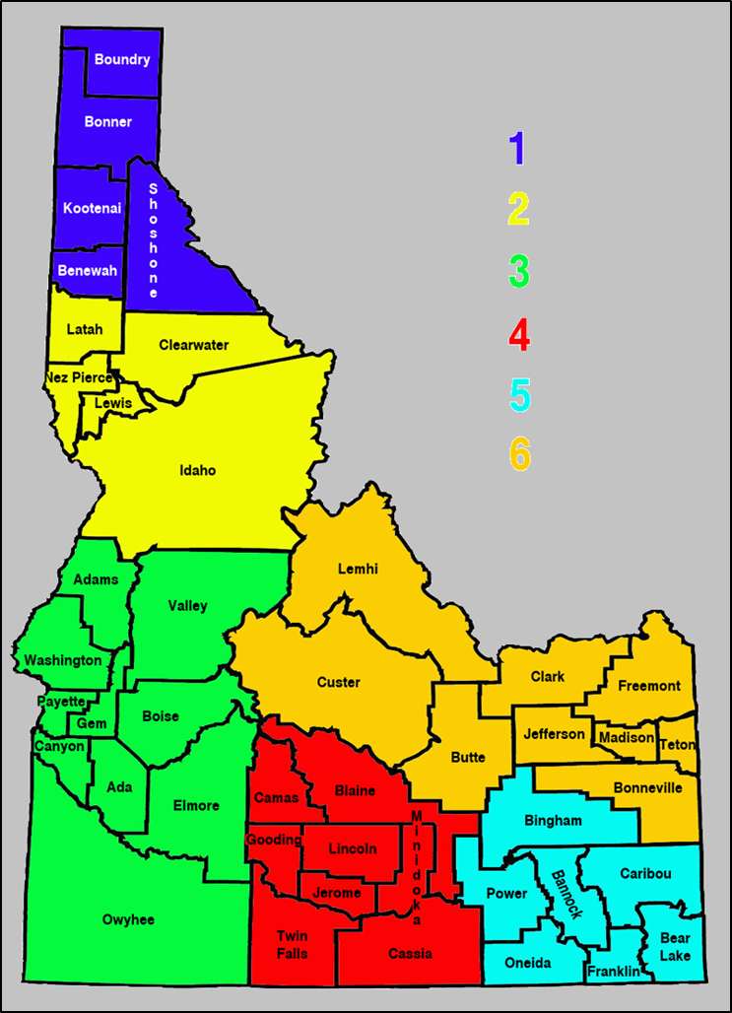
Statewide Temporary Staffing Services- Region Map
Region 1: Benewah, Bonner, Boundary, Kootenai, and Shoshone Counties.
Region 2: Clearwater, Latah, Lewis, Nez Pierce, and Idaho Counties.
Region 3: Ada, Adams, Canyon, Elmore, Gem, Owyhee, Payette, Valley, and Washington Counties.
Region 4: Blaine, Camas, Cassia, Gooding, Jerome, Lincoln, Minidoka, and Twin Falls Counties.
Region 5: Bannock, Bear Lake, Bingham, Caribou, Franklin, Oneida, and Power Counties.
Region 6: Bonneville, Butte, Clark, Custer, Freemont, Jefferson, Lemhi, Madison, Teton Counties.

Slide 8


Awarded Contractors:
Personnel Plus, Inc
22nd Century Technologies, Inc
Beatty's Services Inc
Cogent Infotech Corporation
Athena Consulting, LLC
Ask IT Consulting, Inc
BuzzClan LLC
Express Employment Professionals
ProPeople Staffing Services Inc
(A total of 9 Contracts were Awarded)

Slide 9
Markup Rates By Region/ Category

Slide 10

Categories/Regions Awarded
SBPO20200075
SBPO20200078
SBPO20200080

Slide 11
Categories/Regions Awarded Cont…
SBPO20200077
SBPO20200076
SBPO20200079

Slide 12
Categories/Regions Awarded Cont…
SBPO20200082
SBPO20200081
SBPO20200074

Slide 13
STATE PROCUREMENT ACT:
67-9211. MULTIPLE AWARDS
(3) When a contract for property has been awarded to two (2) or more bidders in accordance with this section, a state agency shall make purchases from the contractor whose terms and conditions regarding price, availability, support services and delivery are most advantageous to the agency.

Slide 14
Ordering Agency’s Responsibilities
Prior to contacting the Awarded Contractor(s), the Ordering Agency is responsible to define details of the request to include, but not be limited to:
Number of temporary staff needed;
Job duties;
Equipment to be used;
Knowledge, skills and education and/or experience;
Computer software to be used;
Hours of work;
Expected length of assignment;
Job related attire;
Position location;
Procuring Agency contact person; and
Other pertinent job-related information.
Depending on the amount of detail required, it is recommended the Ordering Agency submit this information in writing via e-mail or facsimile to reduce the possibility of an inappropriate temporary assignment.
Each Ordering Agency will provide a listing of position classifications to the Awarded Contractor(s); however, the listing is not meant to be all-inclusive. Individual Ordering Agencies may request other temporary positions by way of providing the Awarded Contractor(s) with the employee pay rate, position classification/title and description of duties.

Slide 15

POINT OF CONTACT
The Contractor must provide at least one (1) Point of Contact for Temporary Staffing order placement for the Contract. If the Contractor provides more than one (1) Point of contact, each must be assigned to specific Agencies or Areas of the State. The Contractor must provide a written list of their Point of Contacts to DOP within fifteen (15) business days of the Service Start Date of the Contract, including name(s), contact information, and assigned Agencies or Areas, and must provide timely updates to DOP throughout the Contract term in the event the Point of Contact (or contact information) change.

Slide 16

BILLING PROCEDURE
Invoices must be provided by the Contractor(s) in weekly increments. For invoicing purposes, a week is defined as running from Sunday through Saturday. Contractor(s) must submit each week’s invoice within two weeks of each given week’s end. No invoice will be accepted or paid without receipt of any required documentation. Invoices submitted without the Ordering Agency’s required documentation will be returned to the Contractor for resubmission.
Contractor(s) must use the following invoice procedures:
  Must be submitted on Contractor letterhead.
  Show total number of hours, with regular and overtime listed separately, for each individual temporary staff for that week, include the job description (See Section 6.1) for work performed.
  Hourly rate billed (including mark-up) and total amount billed for each individual temporary staff, based upon the corresponding hours for that week.
  List the total amount of allowable miles reimbursed for each applicable temporary staff for that week.
  List the total amount billed in mileage reimbursements for each individual temporary staff for that week. Ordering Agencies require copies of the mileage logs submitted with the weekly invoices to validate amounts invoiced.
Invoices that contain errors will be returned to the Contractor for correction.
The Contractor will have two (2) weeks to correct the invoices and resubmit to Ordering Agencies.
In addition to the requirements outlined above, the Contractor must provide the following information with each invoice:
  IPRO PO/Contract number.
  Identification of the Ordering Agency’s location that each contracted personnel is working.
  Identification of the week being billed (i.e., beginning and ending date range of week being billed).
  Grand total amount billed for all temporary staff for that week.
  Name of authorized individual and contact information for Contractor.
  Ordering Agencies may have additional requirements, the Contractor(s) must follow individual Ordering Agency’s internal policies.

Slide 17
CONTRACT MONITORING & REPORTING REQUIREMENTS
The State will monitor the Contract utilizing any one (1) or more of the following methods:
In-person or telephonic meeting to discuss performance of the Contract;
Survey of the Contractor and Agencies;
Additional reports submitted from the Contractor; or
3.1.4 Any other means the State chooses to employ to accurately monitor the Contract.
Quarterly Usage Reports are required as outlined in Section 5 of the State of Idaho Standard Contract Terms and Conditions. The SBPO Summary Usage Report can be found on the State of Idaho Purchasing website https://purchasing.idaho.gov/information-for-vendors/.

Slide 18
PERFORMANCE METRICS
1.) Metric Description: Nature and Scope of work to be performed (Section 6) – worker orientation
Required Level of Expectation: 100%
Method of Monitoring: Question temporary staff sent to perform work to ensure they are informed about the job description, hours and days of the week expected to work, health & hygiene policies, hourly wage, workplace safety, personal protective equipment (PPE) requirements.
Strategy for Correcting Non-Compliance: Ordering Agencies will document deficiencies and notify the Contractor in writing if they do not meet the Required Level of Expectation. Ordering Agencies may meet with the Contractor to discuss the issues and potential resolutions. The Contractor will have ten (10) business days after receipt of the written notification to submit a written response to the Agency identifying how they will correct the findings. The Agency may also require the Contractor to submit a Corrective Action Plan which meets the Ordering Agency’s approval. The Corrective Action Plan must be submitted within ten (10) business days after the Contractor has been notified in writing of the findings. Continued non-compliance may result in additional remedies outlined in Section 13 Remedies, up to and including termination of the Contract.
2.) Metric Description: Billing Procedure (Section 8) – Invoice accuracy
Required Level of Expectation: 100%
Method of Monitoring: Frequent review of invoices submitted by Contractor for individual Ordering Agencies. Mark up rate, temporary staff name, location worked, days and hours worked.
Strategy for Correcting Non-Compliance: Ordering Agencies will document deficiencies and notify the Contractor in writing if they do not meet the Required Level of Expectation. The Agency may meet with the Contractor to discuss the issues and potential resolutions. The Contractor will have ten (10) business days after receipt of the written notification to submit a written response to the Agency identifying how they will correct the findings. Ordering Agencies may also require the Contractor to submit a Corrective Action Plan which meets the Ordering Agency’s approval. The Corrective Action Plan must be submitted within ten (10) business days after the Contractor has been notified in writing of the findings. Continued non-compliance may result in additional remedies outlined in Section 13 Remedies, up to and including termination of the Contract.

Slide 19


Questions?
Contract Lead:
Kaylee Starman
Division of Purchasing
(208) 332-1611
Kaylee.Starman@adm.idaho.gov
Notes:
.

Slide 20

Thank you to all the agencies for your input & assistance with this Contract ☺

